Slide 1
Madhav Institute of Technology and
Science
Theory of Computation
(150414)
Name : Hariom Patel Submitted To : Dr. Manis Dixit
Enrollment No. : 0901CS201050

Slide 2
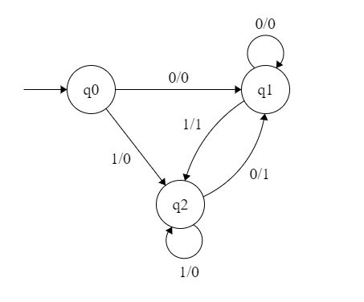
Mealy Machine
A mealy machine is defined as a machine whose output values are determined by both its current state and current inputs. In this machine atmost one transition is possible.
It has 6 tuples: (Q, q0, ∑, O, δ, λ’)
Q is finite set of states
q0 is the initial state
∑ is the input alphabet
O is the output alphabet
δ is transition function (Q×∑ → Q )
λ’ is the output function (Q×∑→ O)
Hariom Patel
0901CS201050

Slide 3
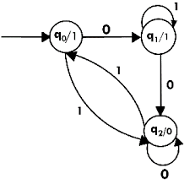
Moore Machine
A moore machine is defined as a machine in whose output values are determined only by its current state.
It has also 6 tuples: (Q, q0, ∑, O, δ, λ)
Q is finite set of states
q0 is the initial state
∑ is the input alphabet
O is the output alphabet
δ is transition function which maps Q×∑ → Q
λ is the output function which maps Q → O
Hariom Patel
0901CS201050

Slide 4
Difference between moore & mealy
Mealy machine
Moore machine
Output depends on present state as well as present input.
If input changes, output also changes.
Less number of states are required.
Asynchronous output generation.
Output is placed on transition
It is difficult to design.
Output depends only upon the present state.
If input changes, output does not change.
More states are required.
Synchronous output and state generation.
Output is placed on state.
Easy to design.
Hariom Patel
0901CS201050

Slide 5
Thank you

